Slide 1

BOOMBASTIC
D4 System Design Exercise 2014
Notes:
Please use the dd month yyyy format for the date for example 11 January 2008. The main title can be one or two lines long.

Slide 2


BOOMBASTIC?
Ballistic Object Orientated project Made from Breadboards And Stuff That I Can solder
SOnic Meat BASTIng deviCe

Slide 3

BOOMBASTIC
Body-Operated
One-Man Band with
Amplification,
Storage and
Transmission
Integrated Circuits

Slide 4
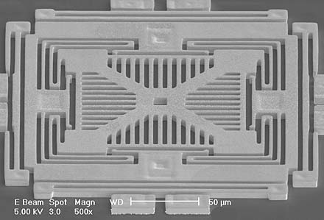
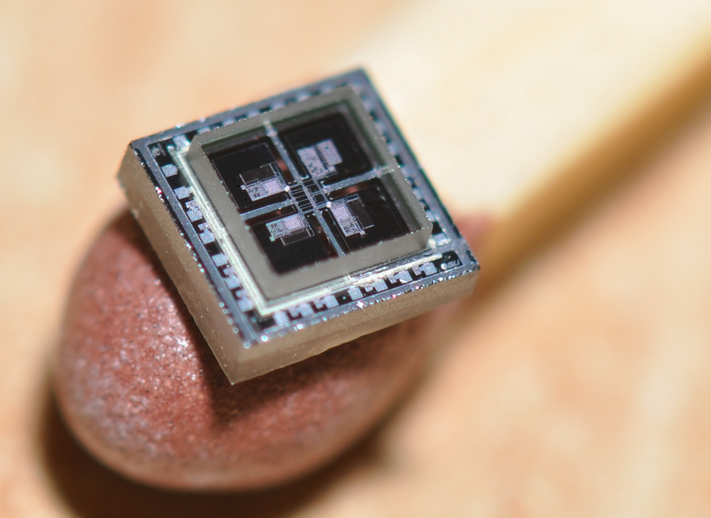
Background
Sensors are now implemented as Micro-Electro-Mechanical Systems
Significantly improved size, weight, cost, power consumption and capability
Allowing new applications in vehicular, entertainment and computing

Slide 5
Scenario
Your team is a small electronic design consultancy
Your customer wishes to manufacture a new audio system for live performances
You have 12 working days to design and build a working prototype
The customer has also contacted 9 other design consultancies to produce competing designs
You will market your product at a trade fair held by the customer, where it will be judged on innovation, features, performance, price, aesthetics and marketing

Slide 6
Requirements
Your product must include the following aspects:
Sensing – e.g. accelerometers, gyroscopes, magnetometers, microphones, pressure, ultrasonic, cameras, buttons, dials
Signal Processing – e.g. synthesising new audio signals or mixing/distorting/transforming pre-recorded samples
Amplification – built in amplifier and speaker with adjustable volume control and 15 kHz bandwidth
Transmission – Real-time wireless transmission to a separate device having a 3.5 mm jack socket
Storage – Performances should be stored so that they can be played back through your device or using a PC, for example
Power management – Batteries should allow continuous operation for at least an hour

Slide 7
What else can it include?
Pretty much anything you like - be as creative as you wish
Stereo audio
Loading samples from standard media
Appearance, mechanical operation, ruggedisation
Display
Karaoke or “Guitar Hero” mode
Special effects

Slide 8
Evaluation
The following points will be considered:
Difficulty of the problem addressed
Entertainment value of the device
Electronic design
Ease of use of the device
Creativity and innovation
Aesthetics
Cost
Reliability
Documentation

Slide 9
Team Working
Key components of D4 are:
Working in groups of 5-6 individuals
Partitioning a large task effectively amongst the group
Initiative, creativity and innovation
Mixed-signal electronic design
Costing and budgeting
Adapting to unexpected events
Time management
Troubleshooting
It is artificial, but it is good preparation for the individual project in year 3, and especially the group project in year 4.

Slide 10
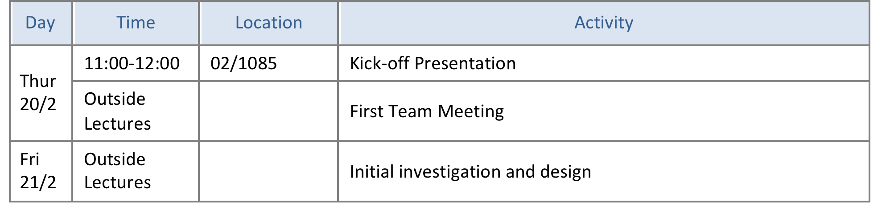
Week 0: Introduction

Slide 11
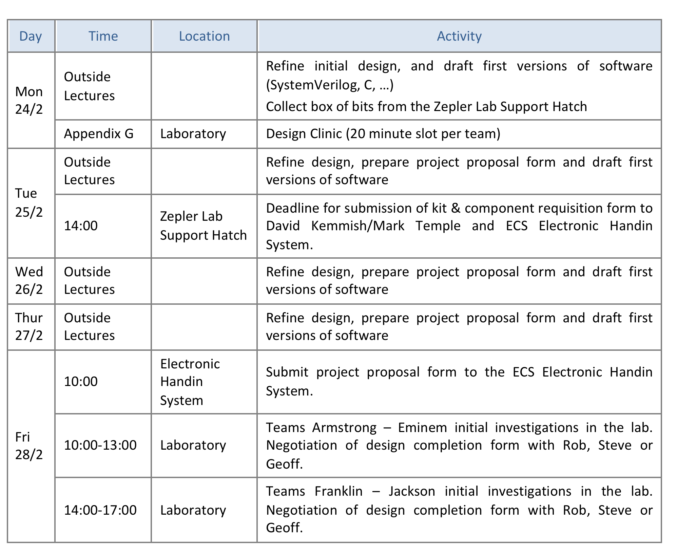
Week 1: Design and simulation

Slide 12
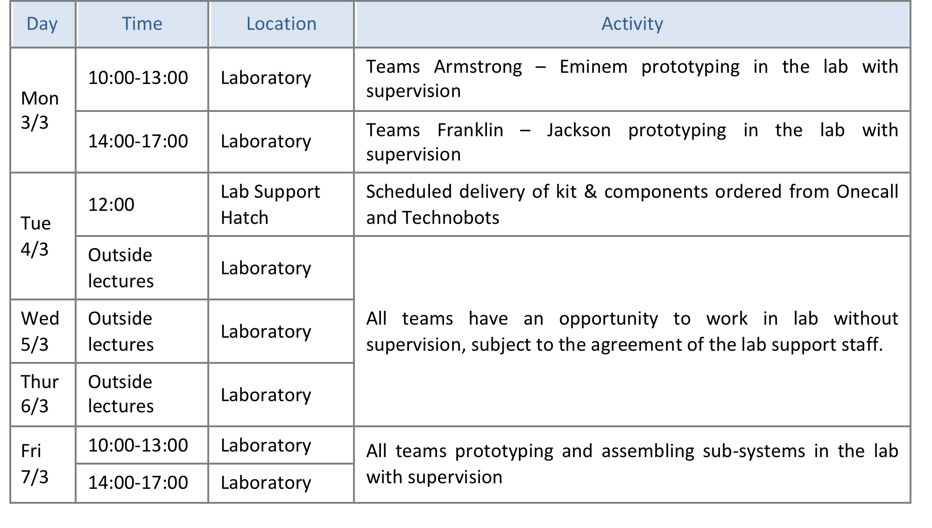
Week 2: Prototyping and construction

Slide 13
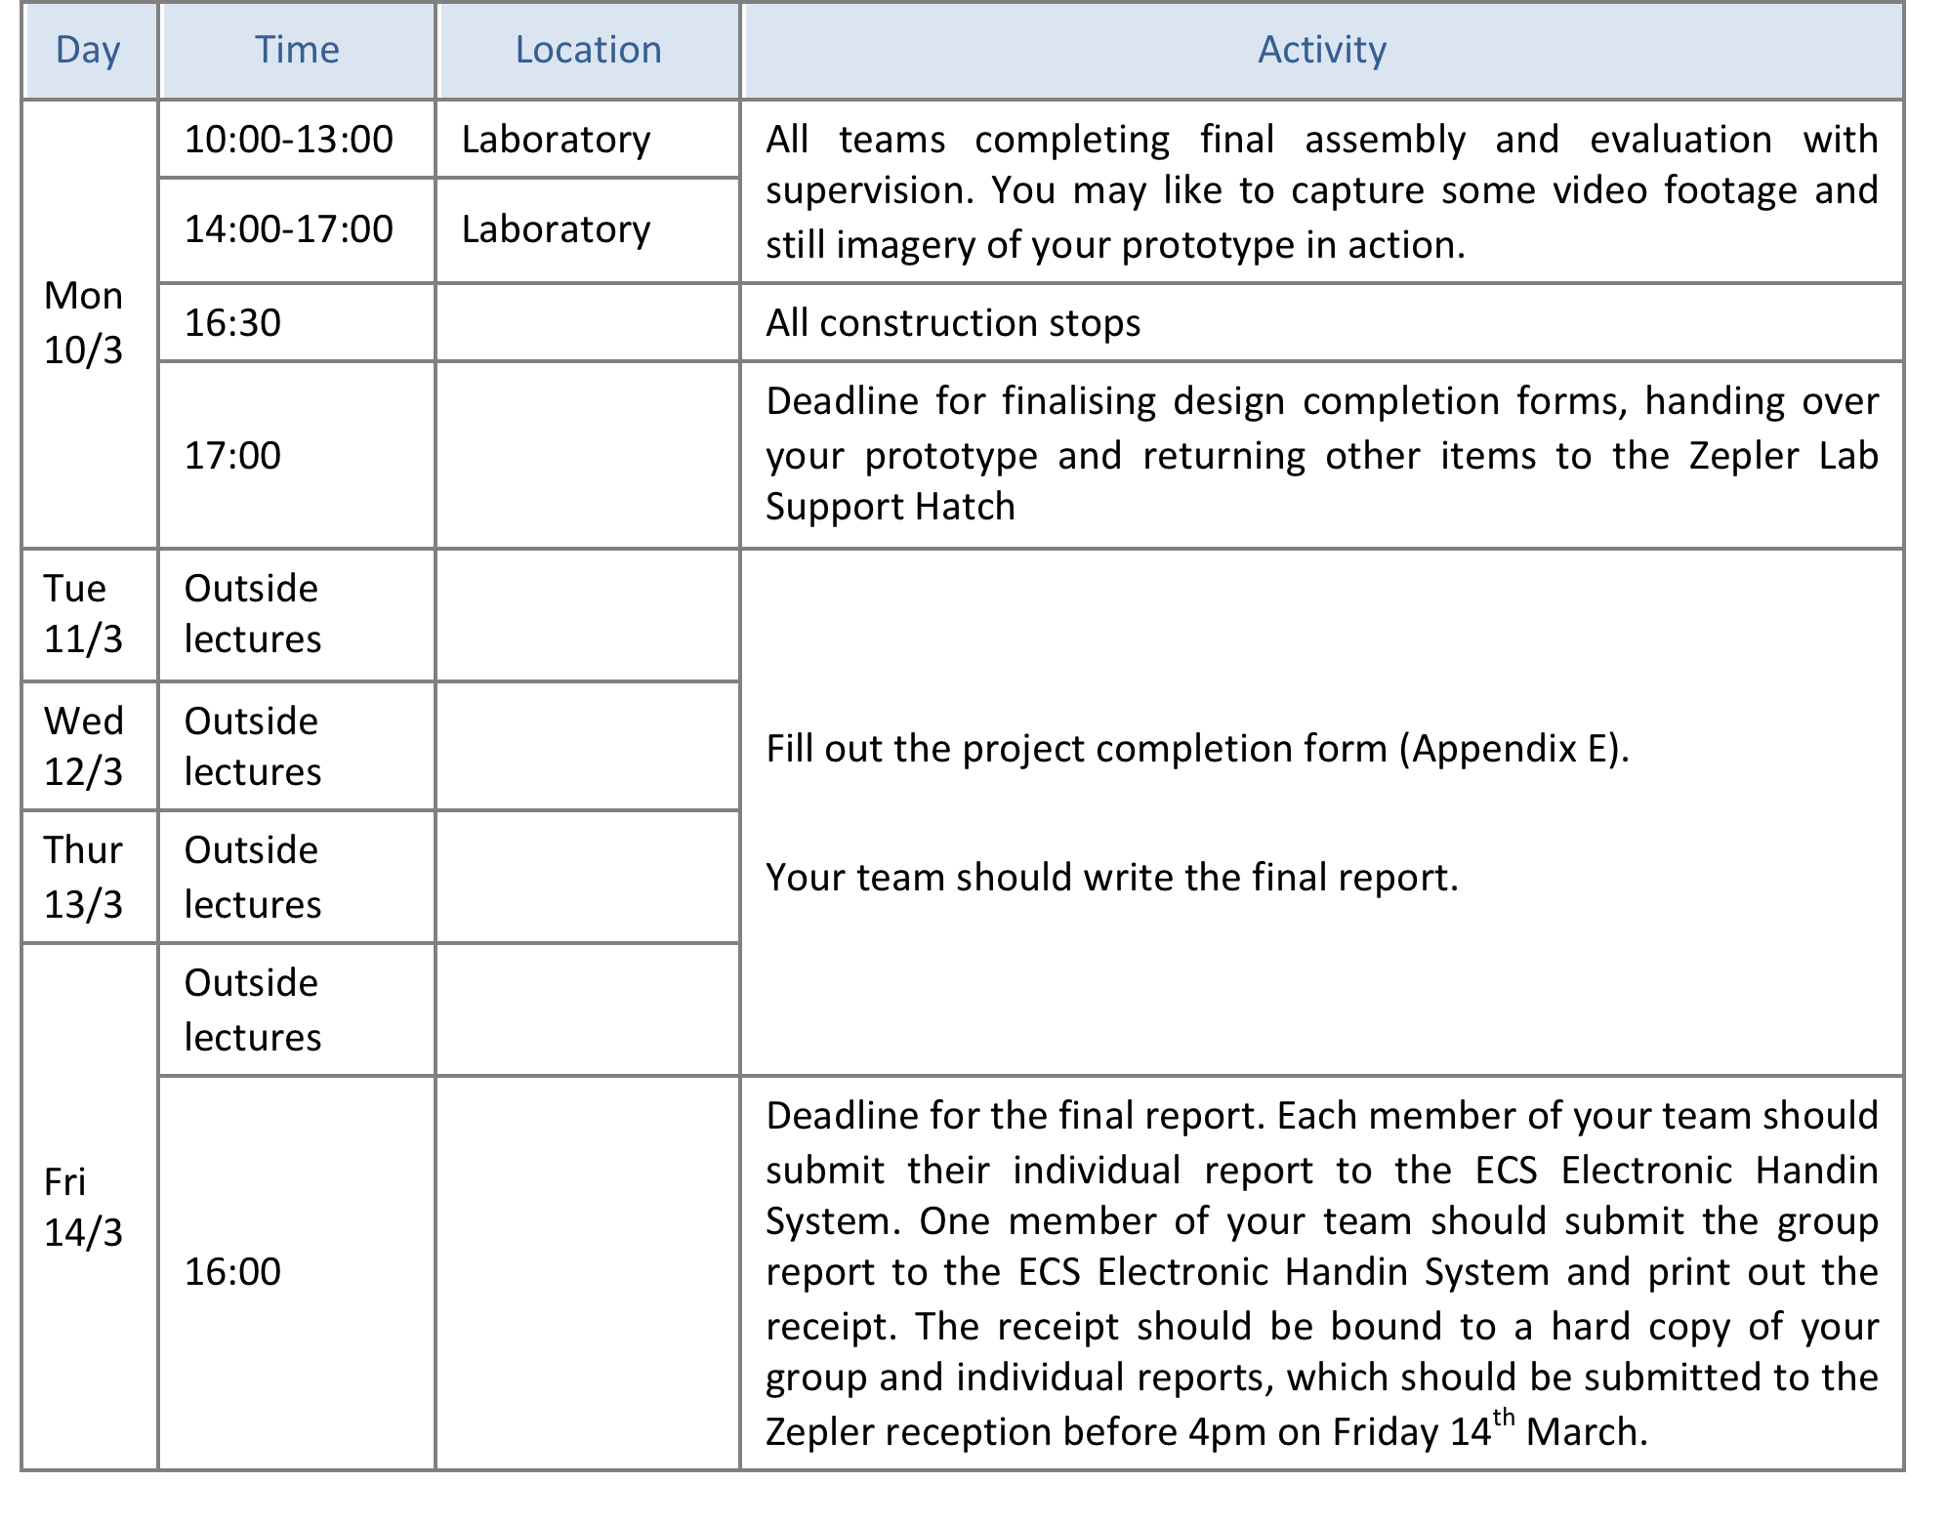
Week 3: Final assembly, evaluation, and report production

Slide 14
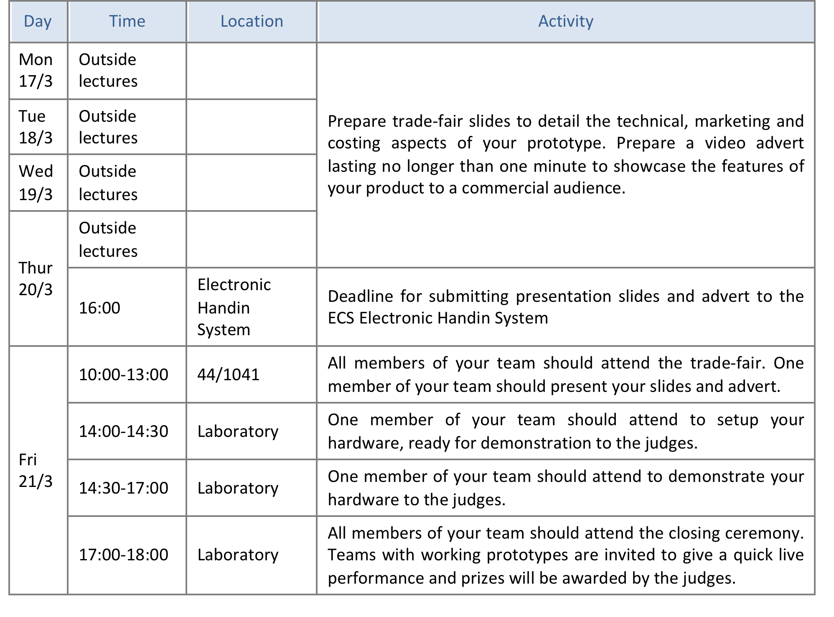
Week 4: Trade Fair

Slide 15
Deliverables and Assessment
The weighting of the deliverables is approximately:
5% Project Proposal Form,
15% Constructed Prototype & Design Completion Form,
5% Project Presentation,
10% Team report (3000 words)
65% Individual report (3000 words)
At the end of the project, your team will have to agree on the effort contributed by each team member. This will be used as an indication of how team marks should be allocated across the team.

Slide 16
How do I get a good mark?
You should expect to put in 75 hours of effort each
You are a team – work as one.
The lab is closed during lecture hours, but make good use of it when it is available to you (don’t skip Lectures).
Good: Innovative, simple, working, maybe partially, but most elements work.
Bad: Complex, faulty, complete system where nothing works.
Good project management:
Use forge.ecs.soton.ac.uk
Skills audit; Identify risks; breakdown tasks; prioritise tasks;
Adapt when things don’t work!

Slide 17
Think about your specification
How will you test your designs?
Keep it simple
Break into smaller pieces
Timing. What is the data rate, bit rate etc? How does this fit with the performance of different components?
Wiring, the less wiring the better, less chance of failure.
Simulation is a tool, use it

Slide 18
Design Clinic
Run by Tim Forcer who has much past experience with D4.
Arrive on time to your allocated 20-minute slot on next Monday.
What to bring?
A sketch of your envisaged product
A 150 word summary describing what it does
A high-level block schematic
Some Questions

Slide 19
Box of Bits
To help you get started we provide each team with some components:
2 AVRs
1 SD card and SD card adapter
1 CPLD
AVR Dragon
2 Xbee modules
Connectors and cables
Il Matto and Il Bagatto prototyping boards
There is no obligation to use any of these components
You will need other components to meet the requirements

Slide 20
What other components can I use?
Anything we have in stock?
Yes (e.g. accelerometer, TFT display, camera, FPGA, etc.)
How do I find out?
Ask stores, but make a list and be prepared. Don’t waste their time. Nominate one member of your team to interact with stores.
Will components be ordered?
Yes, tell us what you need, but don’t go for “canned” solutions. Your team has a budget up to 50 pounds for non-stocked components.
Can I buy my own?
Yes, if you can make a good case for it in your project proposal form.
What components are banned?
Complete canned solutions or design kits
What programming language must I use?
Anything you like that gets the job done

Slide 21
Academic Integrity
You may wish to use elements of hardware or software of other designs you may be able to find. This is only acceptable provided you follow the standard procedures for academic integrity ( https://secure.ecs.soton.ac.uk/kb/entry/35/).
Simply copying large parts of another design will result in a low mark for the exercise. However, re-using and referencing an element from another design because you understand it and think it is good is fine. With software make good use of libraries where they exist – do not write a low-level graphics library for your display if one already exists – use it!
Ultimately, the balance between your own ideas and those of others will moderate the marking of your design.

Slide 22
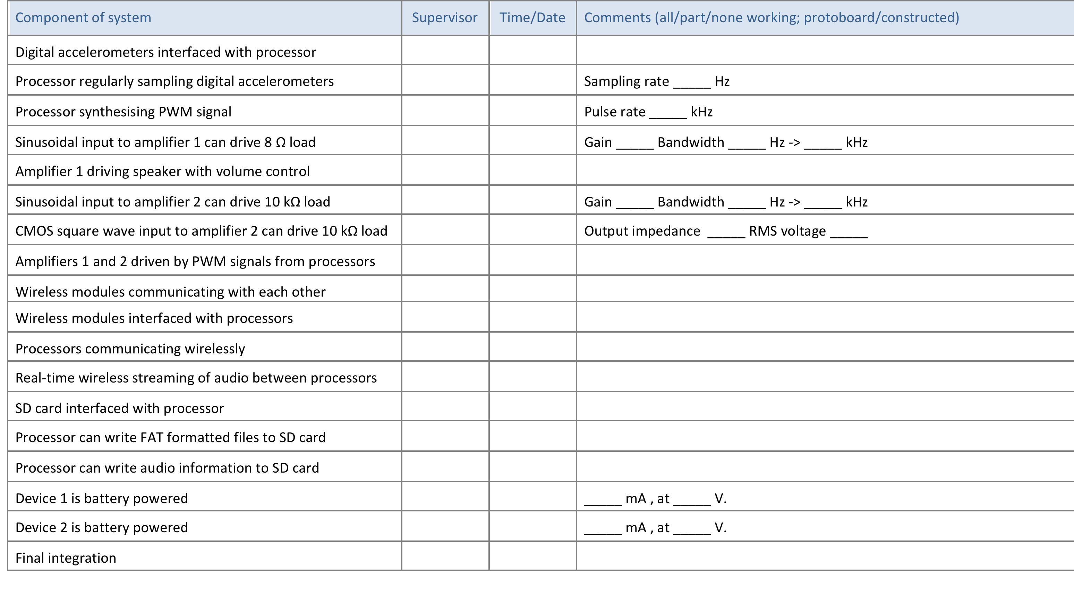
Design completion form
You will define your own milestones which will be signed off by members of staff as you progress. Example below:

Slide 23
Trade Fair
21st March, to pitch your design to the customer and your classmates.
Five minute presentation of your final design, describing:
your target market and costing of your device,
your design,
the problems you encountered,
and the performance of the final prototype.
One minute video advert
Elect one team member to give the presentation
Think how you might make it stand-out from the others.

Slide 24

Detica System Design Prize
This exercise is competitive
100 pounds for each member of winning team
Judging panel made up from ECS and Detica staff
The judgement will be made on the submitted hardware, design completion form and presentation.
The winners will be announced at the trade fair on the afternoon of 21st March.

Slide 25
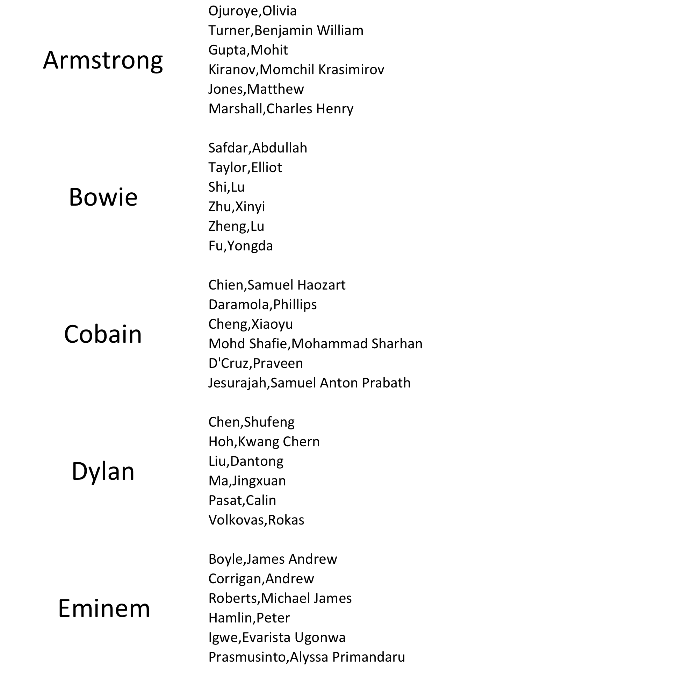
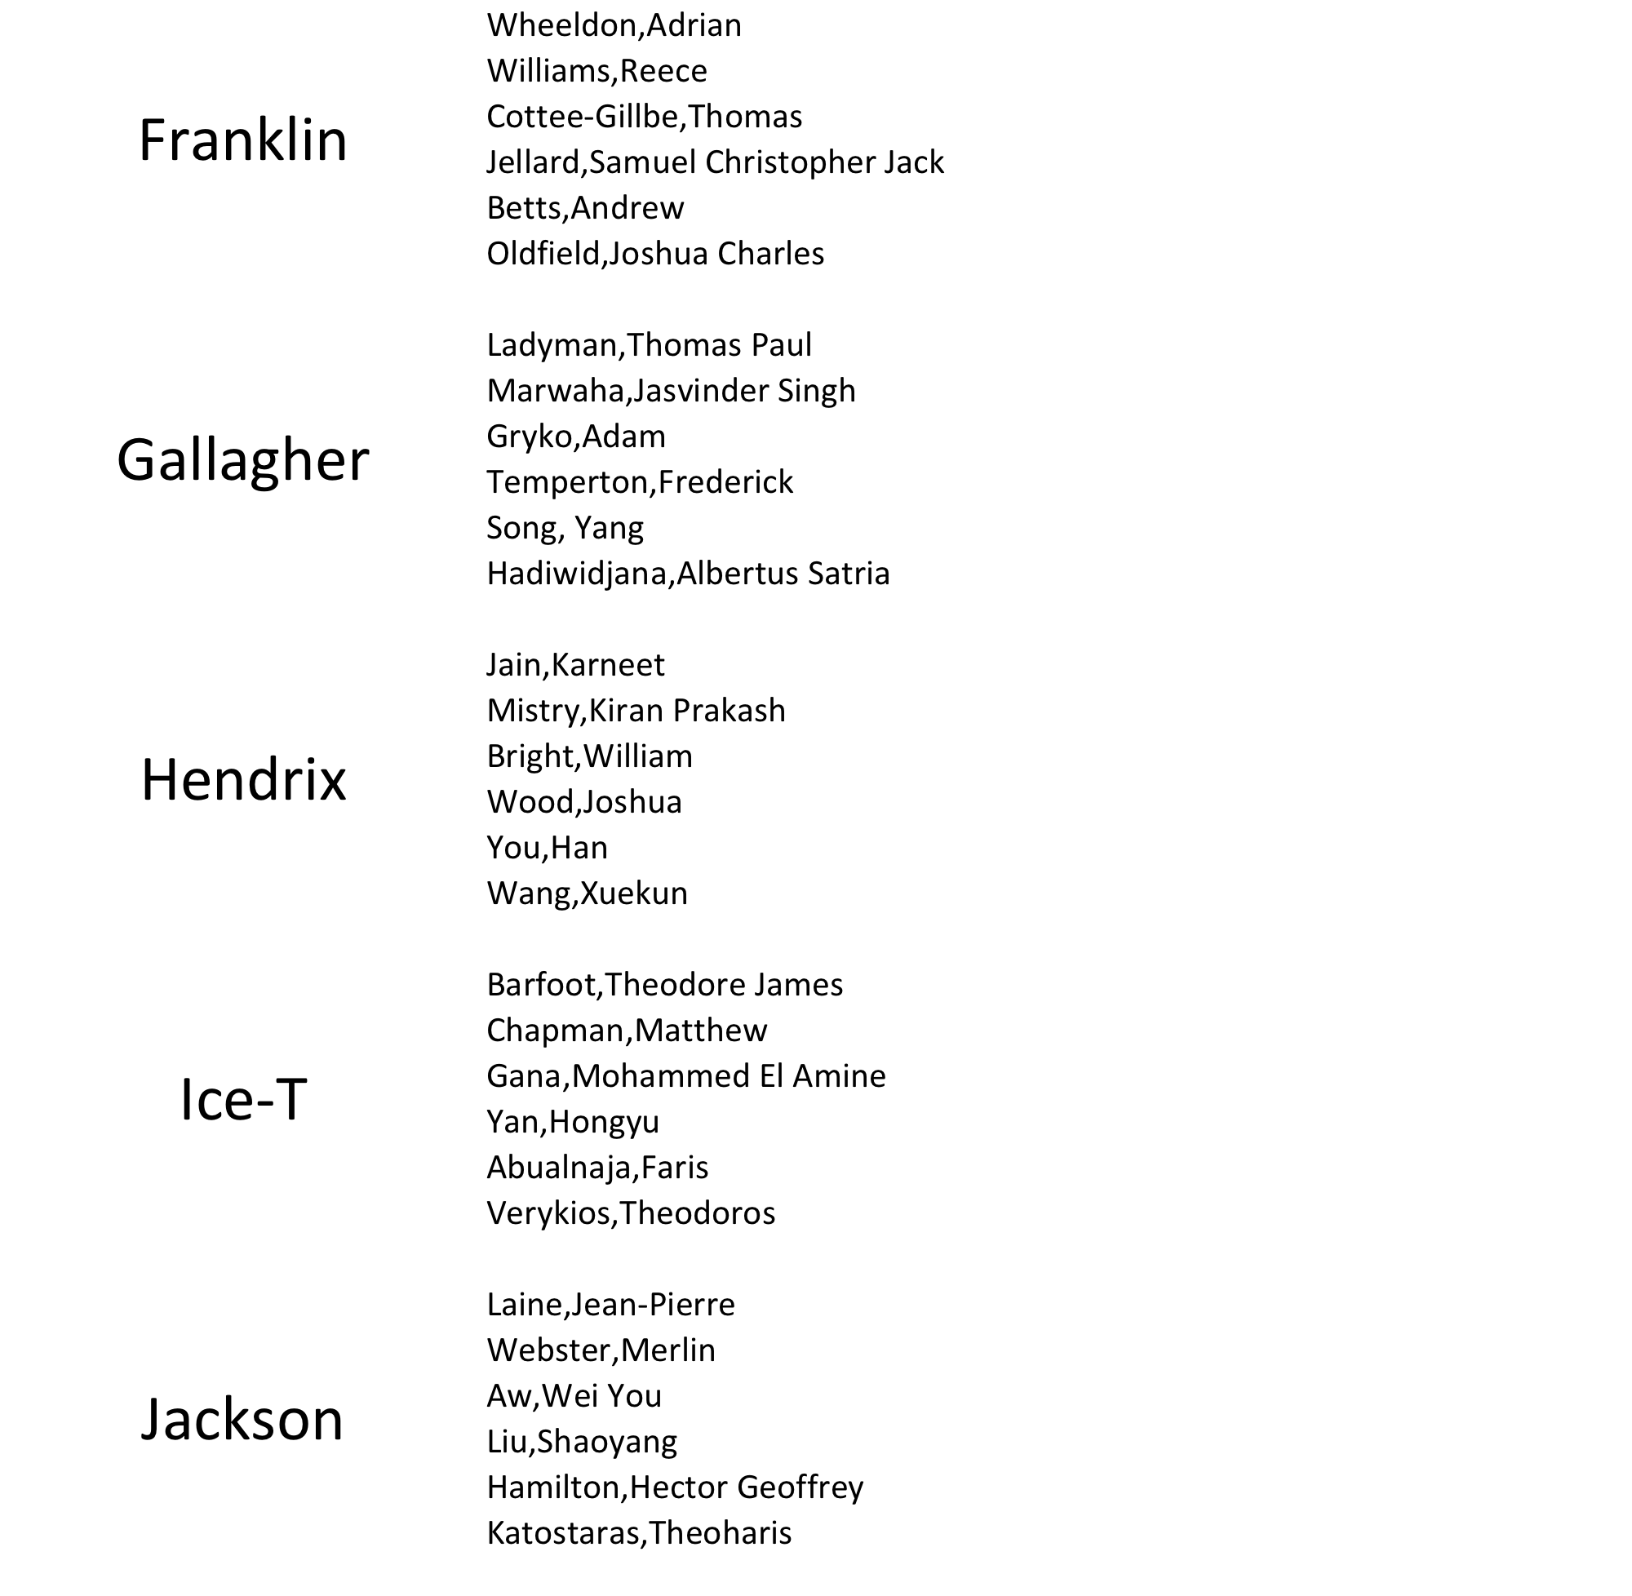
Class list
25

Slide 26
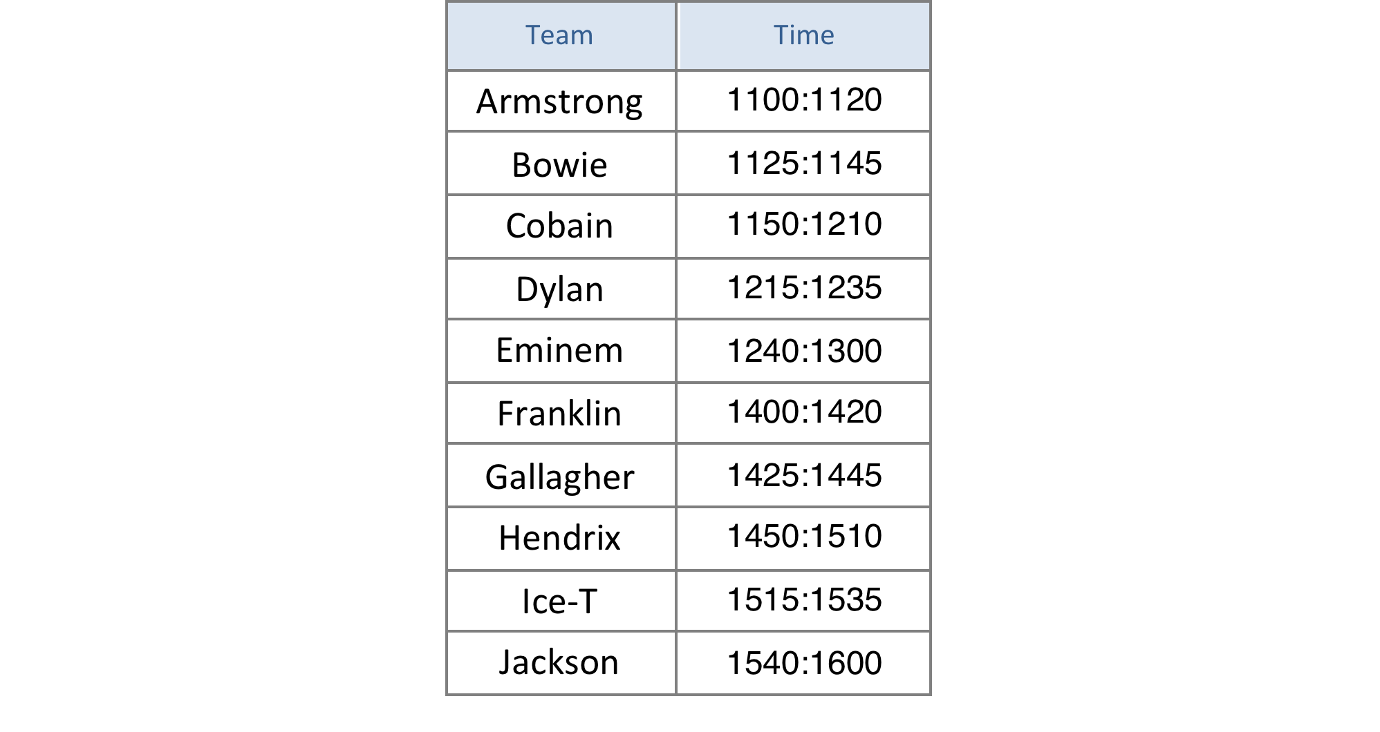
Design Clinic Schedule
Monday 24th February in the D area of the Electronics lab

Slide 27
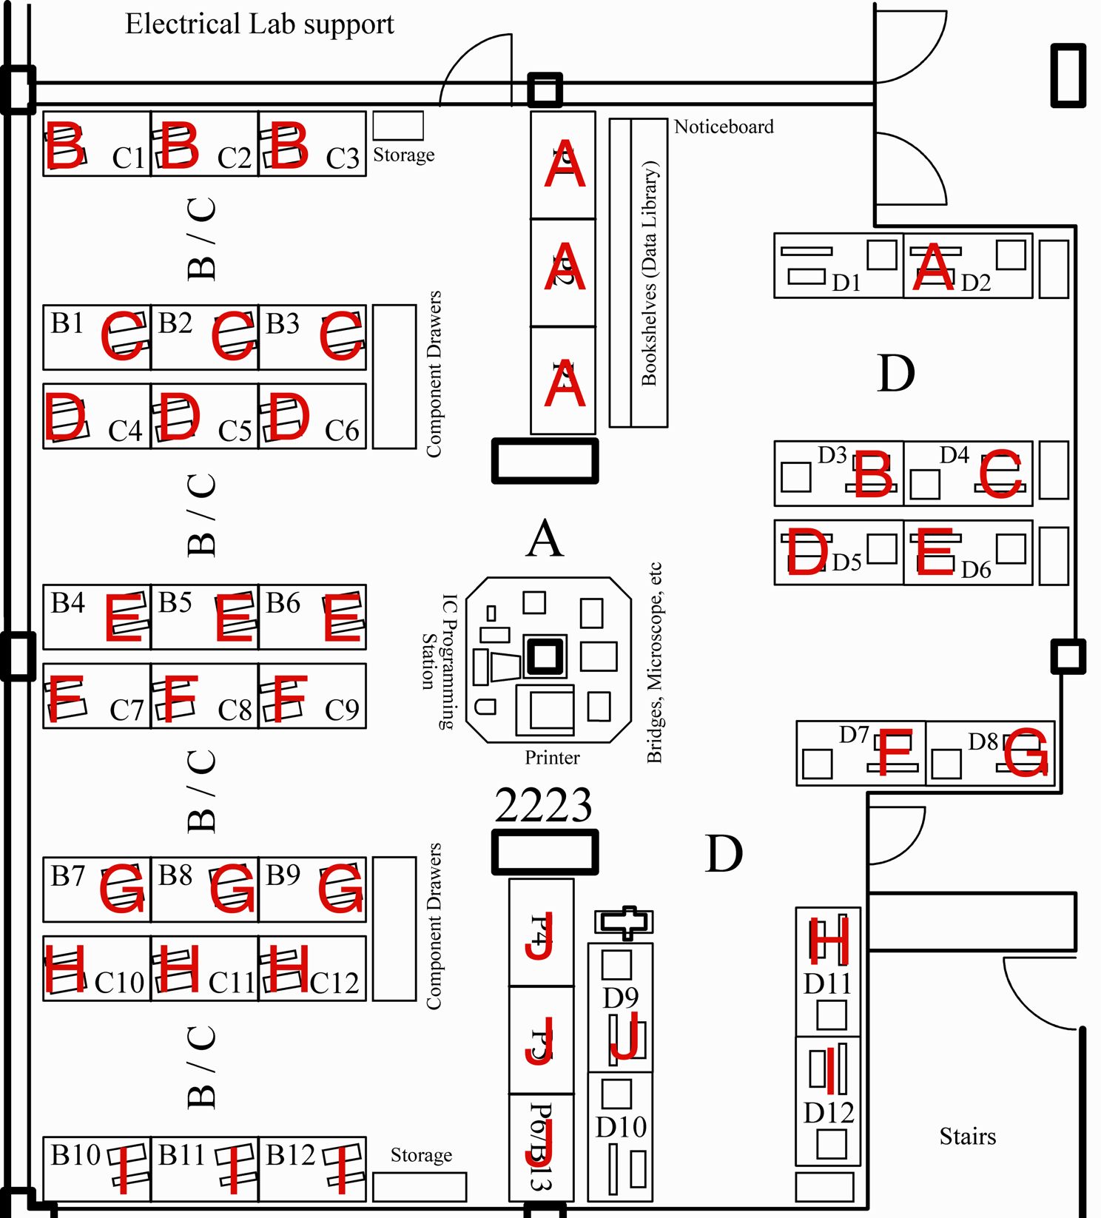
Lab Bench Allocation

Slide 28
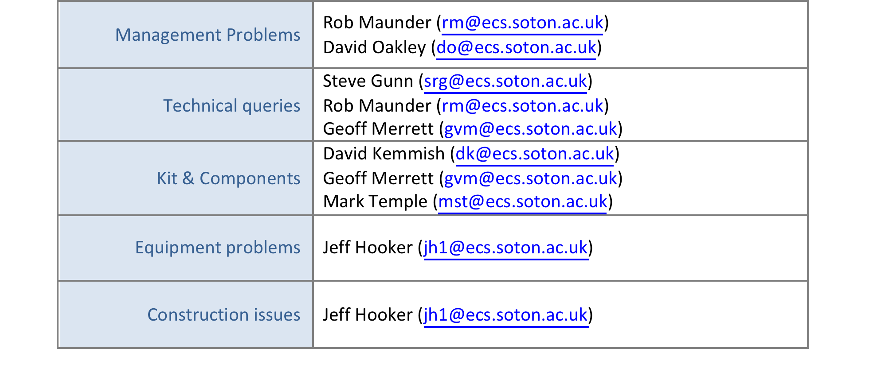
Contact Details
If you have any queries or problems, please contact:
(Mark all messages “D4 Query” to ensure a prompt reply.)

Slide 29
Further Information
D4 website
Handbook
These slides
Requisition form
https://secure.ecs.soton.ac.uk/notes/elec2205/D4/

